Slide 1

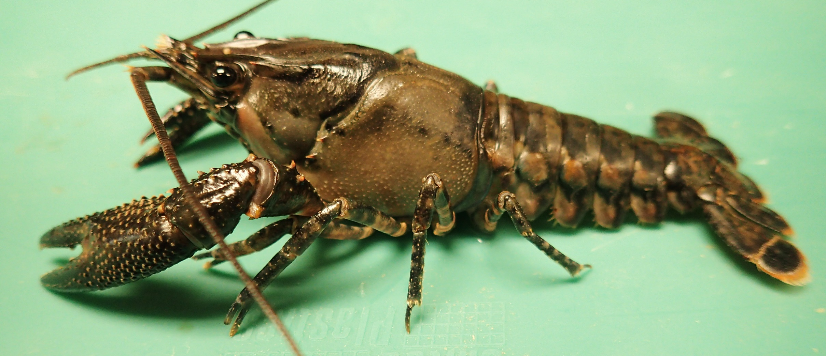
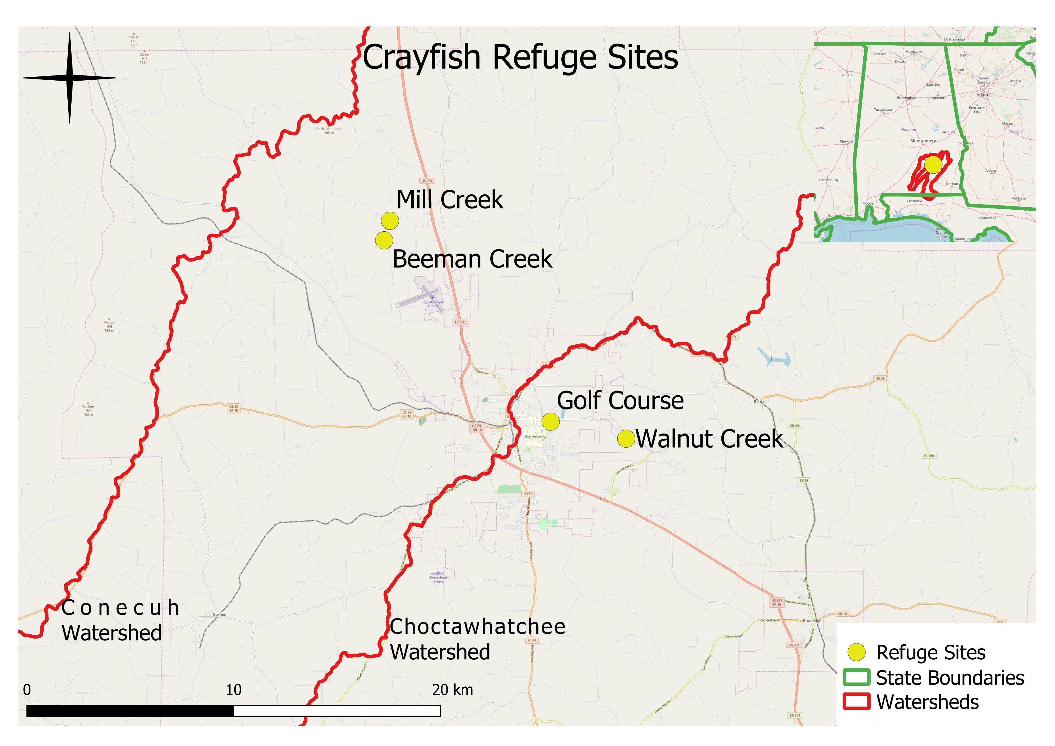
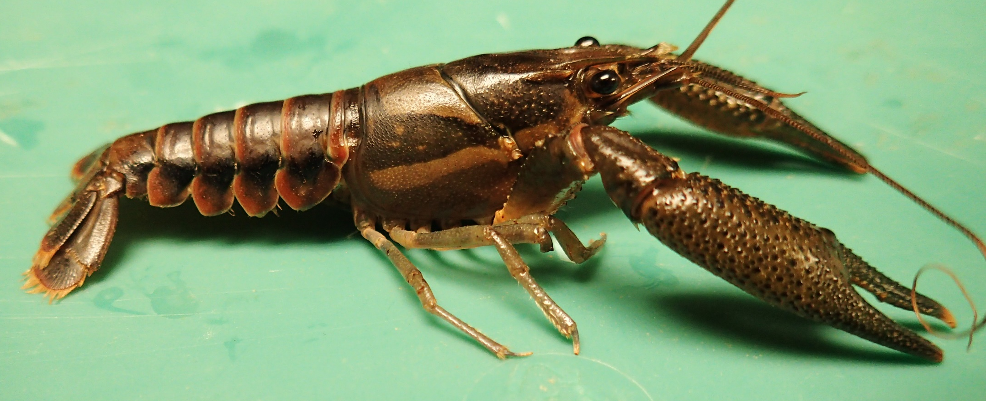
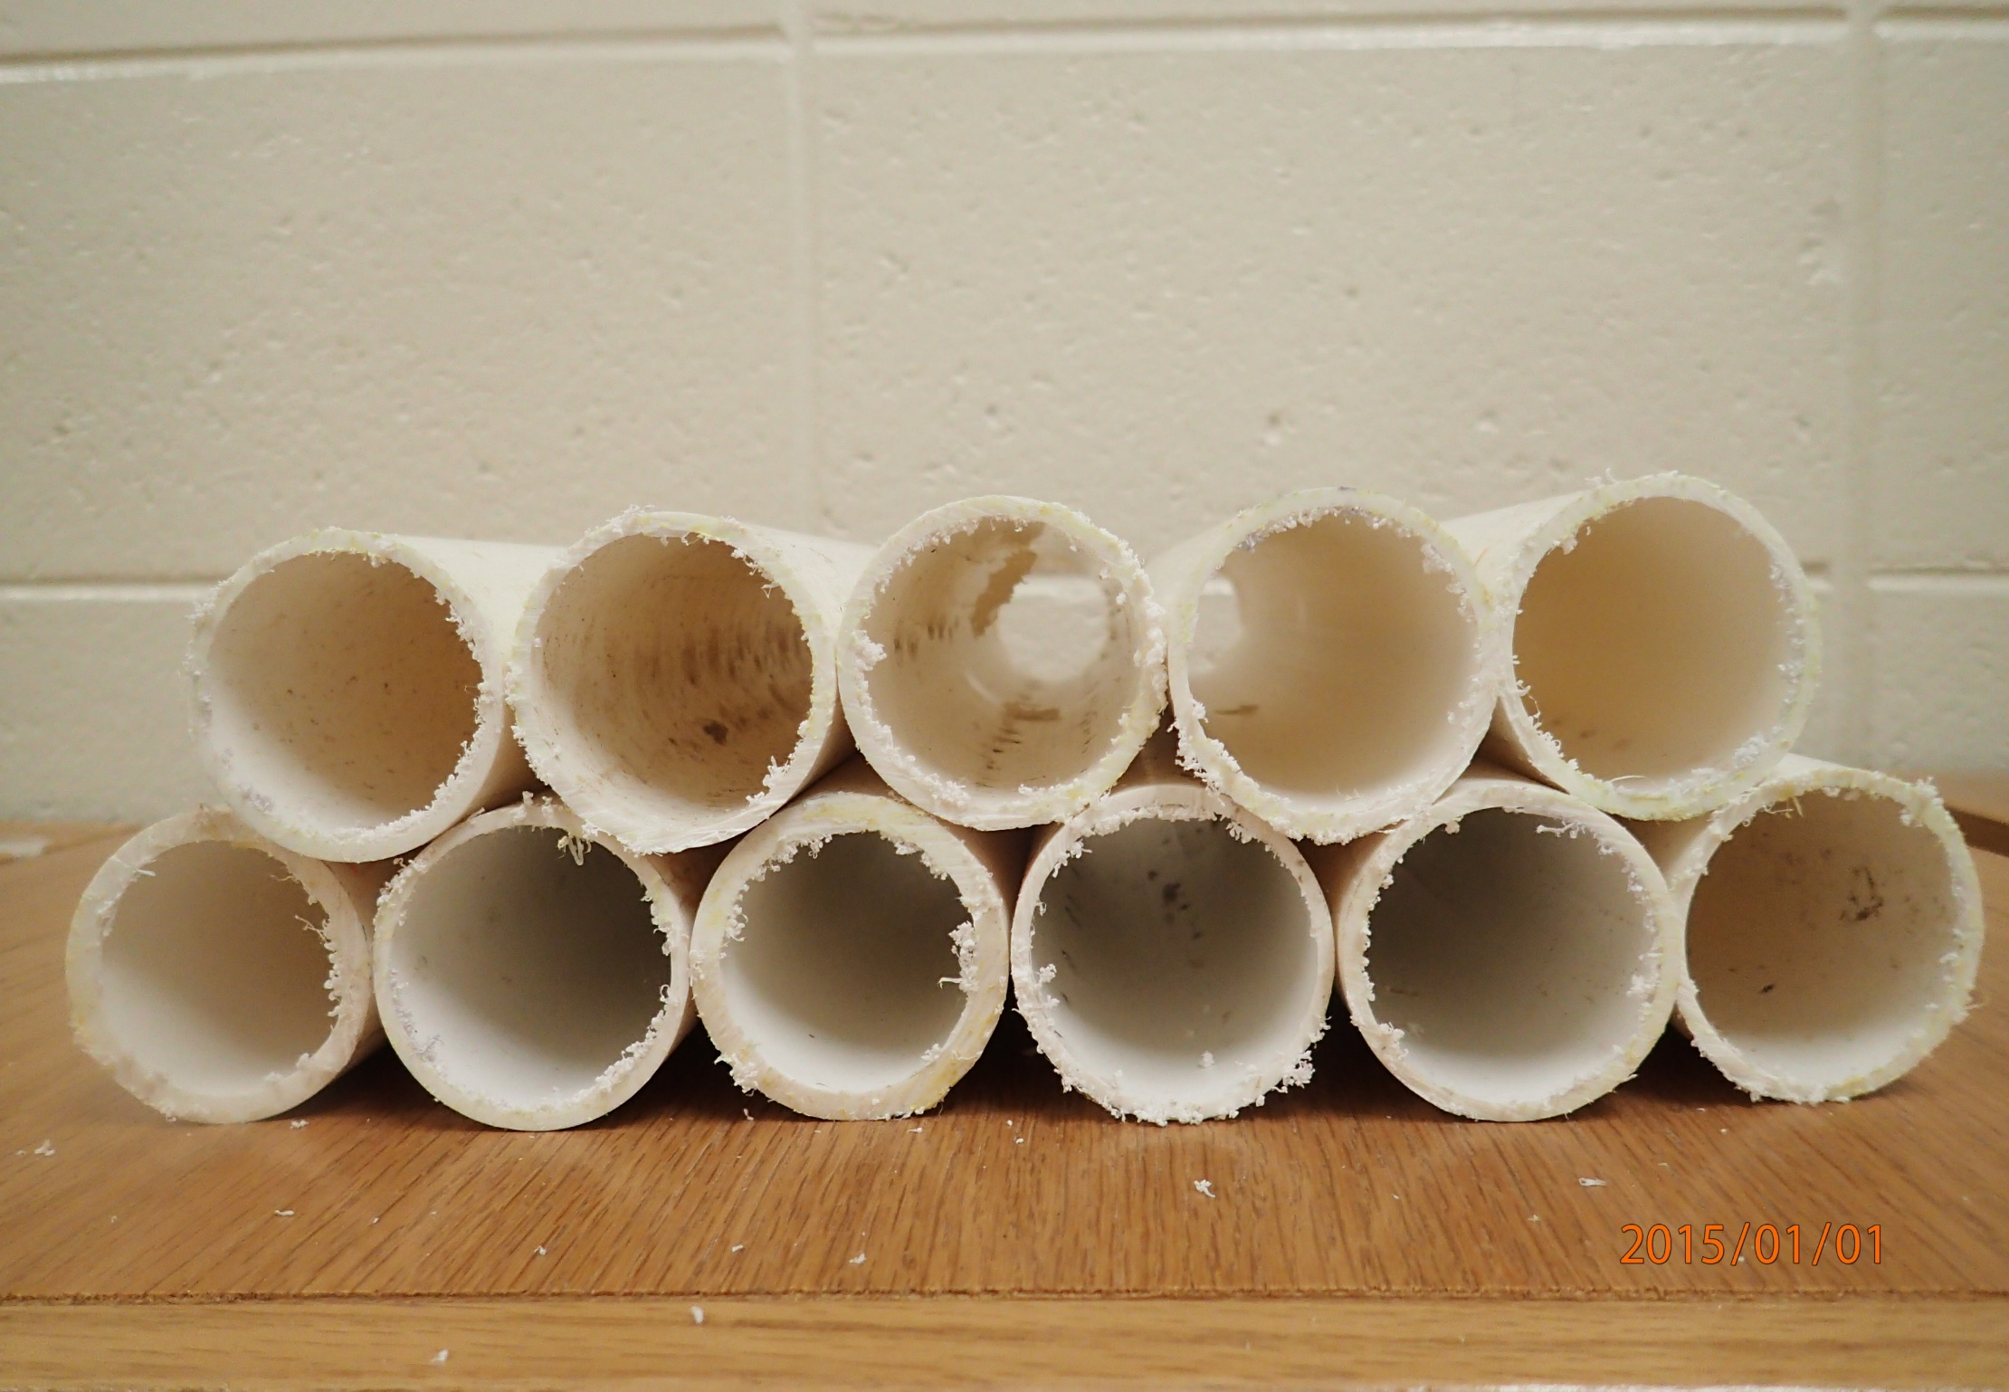
Preliminary Investigations of Refuges as a Method to Capture Riverine Crayfish
Tien Anh Quach, Allison T. Moore, Emma C. Davis, Tanner N. Temple, and Jonathan M. Miller
Troy University, Department of Biological and Environmental Sciences, Troy, AL 36082
Abstract: Over 400 species of crayfish inhabit North America, although relatively little ecological and life history information is available for most species. Sampling techniques usually require labor intensive efforts via dip netting and often electroshocking. Trapping methods have shown to be inefficient in obtaining sufficient numbers for inferences about crayfish populations. A polyvinyl chloride (PVC) pipe refuge design was proposed to passively collect lotic species and compare the same design with baited attractants. Refuges were constructed by connecting multiple parallel pipes, using three individual PVC sizes (1.9, 2.5, and 3.1 cm diameters) of refuges at each site. Two sites were sampled twice weekly (one morning and one afternoon sample/week/site) over four weeks during the Fall 2018 semester, and two additional sites were included during the Spring 2019 semester with bait attached to all refuges. In Fall 2018, a mean of 0.76 ind/refuge of Procambarus suttkusi (target species) were collected in morning samples and 0.30 were collected in afternoon samples. Baited refuges sampled following the same regimen and sites in Spring 2019 resulted in a mean of 0.80 and 1.00, respectively. The additional two sites targeting P. versutus in Spring 2019 yielded results of 0.90 and 0.73, respectively. Smaller diameter refuges (1.9 cm) provided more individuals of P. versutus in Spring 2019, usually around two times more than larger diameter refuges. Procambarus suttkusi collections resulted in variations among refuge diameters utilized, and were likely influenced by the individual size of each crayfish. Future research modifications may compare alterations to bait type, refuge design and/or color, and building larger or more refuges to maximize crayfish collections.
Introduction
The ecology of crayfishes is greatly underrepresented in the literature. Species are currently being described at a faster rate than life history and ecological data are becoming available (Moore et al. 2016). Sampling techniques such as dip netting and electroshocking are often used, but require considerable effort. Additionally, collections of lotic crayfishes using traps has shown to be ineffective as their performances can range from poor (Dorn et al. 2005) to excellent (Olsen et al. 1991). Thus, a polyvinyl chloride (PVC) pipe design was proposed as a source of refugia used to collect lotic crayfishes passively at multiple sites and to compare data to collections with the addition of bait in southeast Alabama streams (Fig. 1).
Methods
Refuges were constructed using PVC pipes approximately 30 cm each in length and connected in a parallel fashion to each other, two layers in height, and about 25-30 cm in width (Fig. 2). Three sizes of PVC (1.9, 2.5, and 3.1 cm diameters) refuges were utilized at each site. Refuges were placed perpendicular, but immediately adjacent to the stream bank at each site. During the Fall 2018 semester, two sites were sampled twice weekly (one morning and one afternoon sample/week/site) in attempts to collect P. suttkusi. During the Spring 2019 semester, two additional sites known to contain P. versutus were incorporated, bait was attached to each refuge at all sites, and the same process was repeated.
Discussion
Increase of capture rates of P. suttkusi in spring may have been a result of bait use, or related to seasonal differences as P. suttkusi starts to reproduce in May (Baker et al. 2008). This species is larger, and is likely the reason larger refuges were generally preferred.
Procambarus versutus, a small crayfish, showed preference for the smallest size of refuges.
Table 1. Mean number of individuals collected by refuge size and site.
Species | Sites | Refuge diameter | Fall mean | Spring mean | Total mean
P. suttkusi | Golf Course | 1.9 cm | 0.11 | 0.50 | 0.32
 |  | 2.5 cm | 0.56 | 0.90 | 0.74
 |  | 3.1 cm | 0.89 | 1.30 | 1.11
 | Walnut Creek | 1.9 cm | 0.56 | 1.10 | 0.84
 |  | 2.5 cm | 0.44 | 0.40 | 0.42
 |  | 3.1 cm | 0.44 | 0.70 | 0.58
P. versutus | Mill Creek | 1.9 cm | - | 0.90 | 0.90
 |  | 2.5 cm | - | 0.10 | 0.10
 |  | 3.1 cm | - | 0.60 | 0.60
 | Beeman Creek | 1.9 cm | - | 2.20 | 2.20
 |  | 2.5 cm | - | 1.20 | 1.20
 |  | 3.1 cm | - | 0.40 | 0.40
Photograph 1. The species of P. suttkusi (top) and P. versutus (bottom).
Figure 1. Site map of locations sampled in the Conecuh and Choctawhatchee River watersheds in southeast Alabama using crayfish refuges.
Results
Procambarus suttkusi: In Fall 2018, a mean of 0.76 individuals per refuge were collected in morning samples and 0.30 were collected in afternoon samples. Baited refuges in Spring 2019 resulted in a mean of 0.80 and 1.00, respectively.
Fall samples showed subtle differences in refuge size preference, although spring samples further supported that larger diameter refuges (3.1 cm) are likely preferred by this species (Table 1).
Procambarus versutus: Morning and afternoon samples at the two additional sites in Spring 2019 yielded results of 0.90 and 0.73 individuals/refuge, respectively.
Of the 54 individuals found in refuges, 38 were collected at Beeman Creek (Fig. 3).
Showed a preference for 1.9 cm diameter refuges, for both morning and afternoon samples, with 31 of 54 collected from the smallest refuge size.
Without bait, refuges results were higher in the morning. With bait, both morning and afternoon samples yielded the same number of individuals collected (Fig. 4).
Figure 3. Number of P. versutus collected in Spring 2019.
Figure 4. Number of individuals collected in morning
and afternoon samples.
Acknowledgements
We thank Wyatt Monday, Meet Patel, David Jackson, and Randall Bassham for assistance.
Literature Cited
Baker, A. M., Stewart, P. M., & Simon, T. P. (2008). Life History Study of Procambarus suttkusi in Southeastern Alabama. Journal of Crustacean Biology 28(3), 451-460. doi:10.1651/07-2895r.1
Dorn, N. J., Urgelles, R., & Trexler, J. C. (2005). Evaluating active and passive sampling methods to quantify crayfish density in a freshwater wetland. Journal of the North American Benthological Society 24(2), 346-356. doi:10.1899/04-037.1
Moore, M. J., DiStefano, R. J., & Larson, E. R. (2013). An assessment of life-history studies for USA and Canadian crayfishes: identifying biases and knowledge gaps to improve conservation and management. Freshwater Science 32(4), 1276-1287. doi:10.1899/12-158.1
Olsen, T. M., Lodge, D. M., Capelli, G. M., & Houlihan, R. J. (1991). Mechanisms of Impact of an introduced Crayfish (Orconectes rusticus) on Littoral Congeners, Snails, and Macrophytes. Canadian Journal of Fisheries and Aquatic Sciences 48(10), 1853-1861. doi:10.1139/f91-219
Figure 2. Refuge design, constructed of consecutive attached PVC pipes.

